Slide 1
Enhancing Reports Using the Data Model: Creating Columns
Notes:
Schedule: Timing Topic
<xx> minutes Lecture
<xx> minutes Practice
<xx> minutes Total

Slide 2
Objectives
After completing this lesson, you should be able to
do the following:
  Describe various Data Model columns
  Display the contents of a file
  Identify characteristics of user-defined columns
  Create report summaries and subtotals
  Derive data using a formula column
  Create and populate a placeholder
Notes:
Lesson Aim
<Enter lesson aim here.>

Slide 3
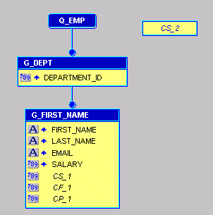
Data Model Columns
5
1
2
3
4

Slide 4
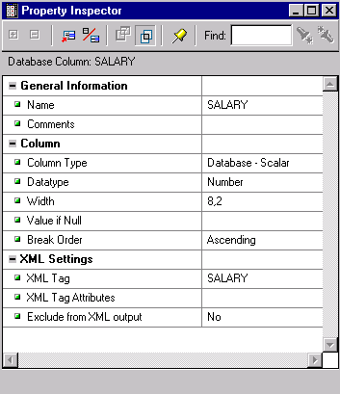
Maintaining Data Source Columns
1

Slide 5
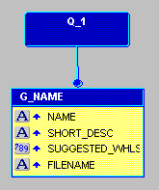
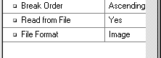
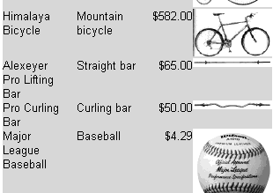
Producing File Content Output

Slide 6
Creating a Column
Summary column
  What type of value?
  Choose the correct column tool
  What frequency?
  Create in a group or
  at report level
Formula column
Placeholder column
C_xxx
C_xxx
C_xxx

Slide 7
Summary Column
  Specific properties:
    Function
    Source
    Reset At
    Compute At
  Data type depends on Source data type
  Page summaries: Not supported in the wizard

Slide 8
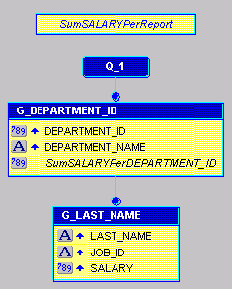
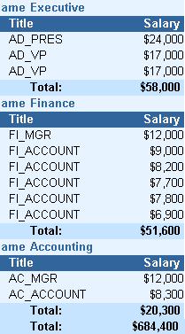

Displaying Subtotals
Reset At:
G_DEPARTMENT_ID
Report
1
2

Slide 9
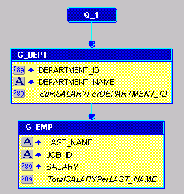
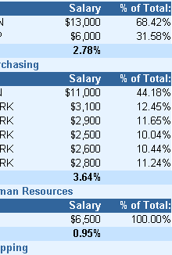
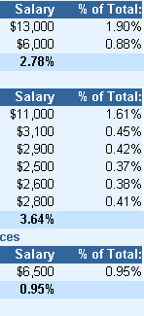
Displaying Percentages
Reset At: G_EMP
Compute At: G_DEPT
G_EMP
Report
1
2

Slide 10
Resetting Summary Values
REPORT
Grand Total
Running Total
Running Total
G_DEPT
XXXX
Sub Total
Running Total
G_EMP
XXXX
XXXX
Record Total
Data Model
Group
REPORT
G_DEPT
G_EMP
Reset At

Slide 11
Formula Column
  Performs a user-defined computation
  Executes a PL/SQL function
  Must return a value
  Can be Character, Number, or Date
  Returned value must match data type
function CF_SALCALCFormula return Number is
begin
return(my_function(:salary));
end;

Slide 12
Placeholder Column
  An empty container at
  design time
  Populated by another object at run time
    Before Report trigger
    Formula column at report level
    Formula column in same group or below placeholder
CP_xxx
CF_xxx

Slide 13
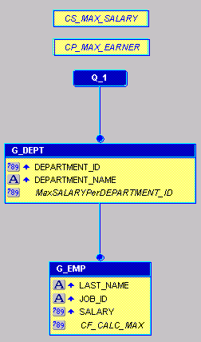

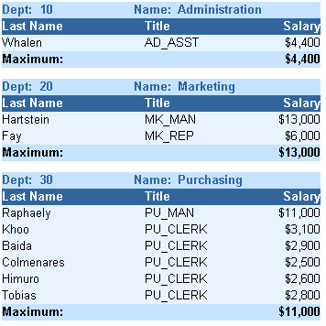
Populating a Placeholder Column

Slide 14
Summary
  In this lesson, you should have learned how to:
  Identify column types and their uses
  Create Summary columns
  Define valid summary levels in a report
  Specify column properties based on required output:
    Reset At: Resets to zero
    Compute At: % of Total only
  Create Formula columns to return values
  Create Placeholder columns to hold values

Slide 15
Practice 10 Overview
  Creating a new report with summaries
  Adding summary calculations to an existing report
  Creating a new report with ranking summary columns
  Adding placeholders for highest and lowest values

